Slide 1
Software Architecture Patterns and Styles
Notes Adapted from:
Software Architecture: Foundations, Theory, and Practice, Taylor et al.
Modeling and Simulating Software Architectures: The Palladio Approach, Reussner et al.

Slide 2
The Grand Tool: Refined Experience
Experience must be reflected upon and refined.
The lessons from prior work include not only the lessons of successes, but also the lessons arising from failure.
Learn from success and failure of other engineers
Literature
Conferences
Experience can provide that initial feasible set of “alternative arrangements for the design as a whole”.

Slide 3
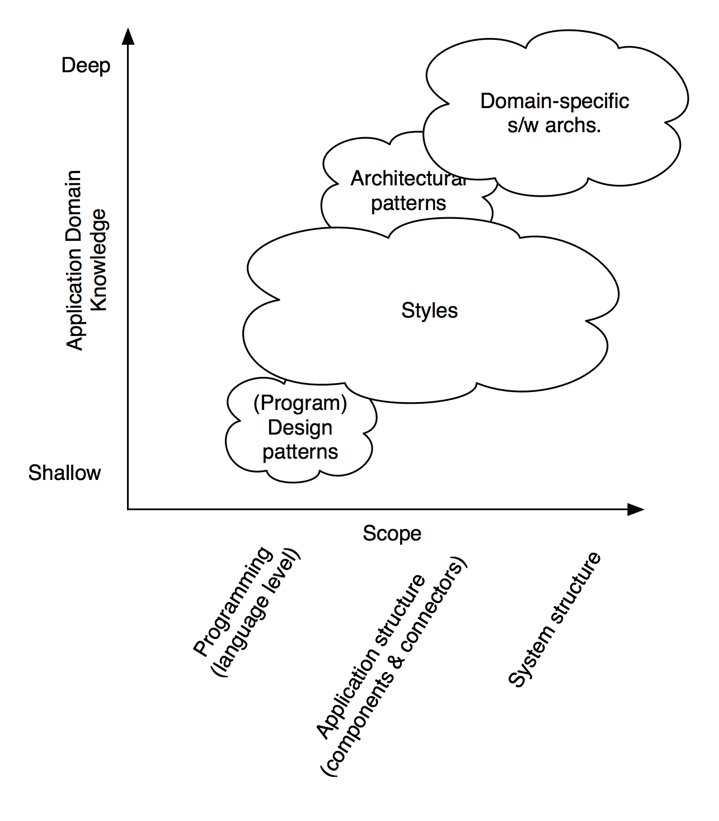
Patterns, Styles, and DSSAs
Software Architecture: Foundations, Theory, and Practice; Richard N. Taylor, Nenad Medvidovic, and Eric M. Dashofy; © 2008 John Wiley & Sons, Inc. Reprinted with permission.

Slide 4
Domain-Specific Software Architectures
A DSSA is an assemblage of software components
specialized for a particular type of task (domain),
generalized for effective use across that domain, and
composed in a standardized structure (topology) effective for building successful applications.
Since DSSAs are specialized for a particular domain they are only of value if one exists for the domain wherein the engineer is tasked with building a new application.
DSSAs are the pre-eminent means for maximal reuse of knowledge and prior development and hence for developing a new architectural design.

Slide 5
Architectural Patterns
An architectural pattern is a set of architectural design decisions that are applicable to a recurring design problem, and parameterized to account for different software development contexts in which that problem appears.
Architectural patterns are similar to DSSAs but applied “at a lower level” and within a much narrower scope.

Slide 6
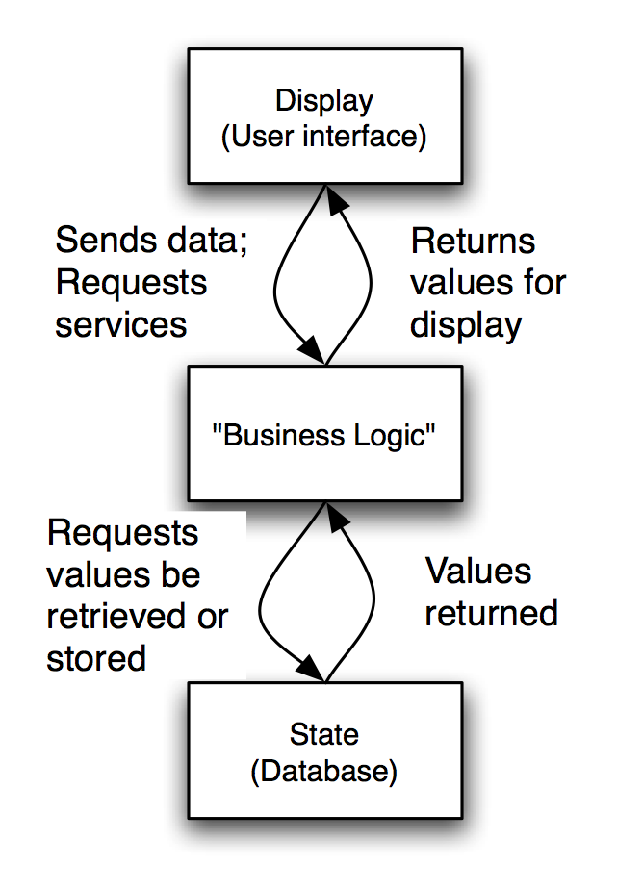
State-Logic-Display: Three-Tiered Pattern
Application Examples
Business applications
Multi-player games
Web-based applications
Software Architecture: Foundations, Theory, and Practice; Richard N. Taylor, Nenad Medvidovic, and Eric M. Dashofy; © 2008 John Wiley & Sons, Inc. Reprinted with permission.

Slide 7
Model-View-Controller (MVC)
Objective: Separation between information, presentation and user interaction.
When a model object value changes, a notification is sent to the view and to the controller. So that the view can update itself and the controller can modify the view if its logic so requires.
When handling input from the user the windowing system sends the user event to the controller; If a change is required, the controller updates the model object.

Slide 8
Model-View-Controller Pattern
MVC divides a program’s components into three categories:
Models: Portions of a program that realize problem-domain function
Holds data and operations for achieving the computational goals of the program independent of its user interface
Views: A way to display a component
Data displayed in views come directly from one or more models (i.e. labels and graphics)
Controllers: Components receive and carry out commands from users
Controllers may alter views or models (i.e. buttons, scrollbars)

Slide 9
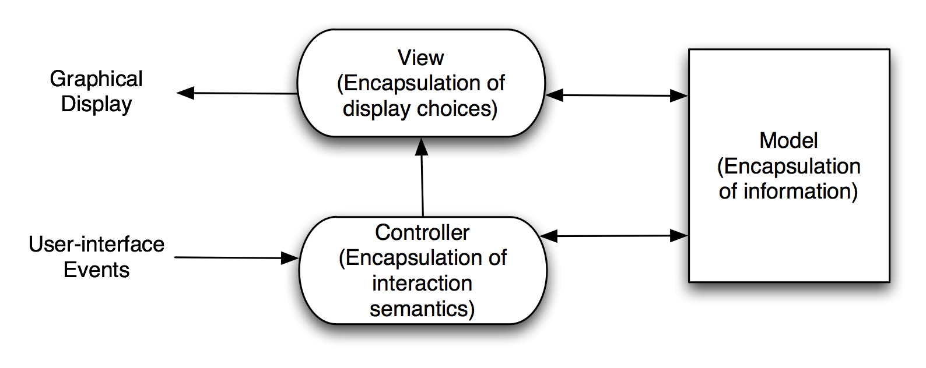
Model-View-Controller (Taylor’s Simplified View)
Software Architecture: Foundations, Theory, and Practice; Richard N. Taylor, Nenad Medvidovic, and Eric M. Dashofy; © 2008 John Wiley & Sons, Inc. Reprinted with permission.
Notes:
Draw a graph as an example
Graph drawn as circles and lines
Graph drawn as a bit matrix: a 1 indicates that those two nodes (x, y) are connected

Slide 10
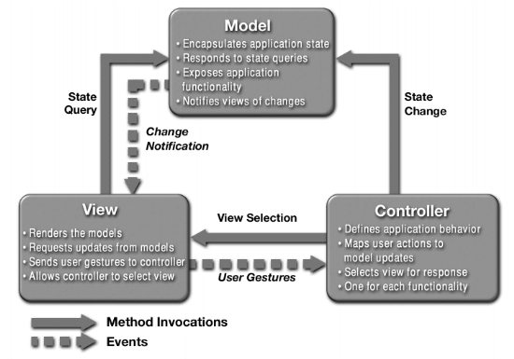
MVC Example (With Directional Relationship)

Slide 11
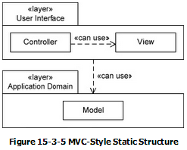
MVC Static Structure
MVC Static Structure
Static Structure: uses Layered Style
A program is partitioned into a user interface module which consists of views and controllers
Application-domain module contains of all models
Views and controllers are allowed to use models, but models do not use controllers or views.

Slide 12
MVC Dynamic Structure
MVC Dynamic Structure
User only manipulates controllers
A controller may alter a view or a model
If a view is altered by controller, it redisplays itself
Once controller finishes altering the model, the model issues a notification that it has changed
Announce an event or directly notifying controllers and views
Views and controllers that receive the model’s notification can reconfigure or redisplay themselves

Slide 13
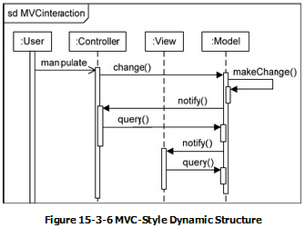
MVC Dynamic Structure
MVC Behaviour
User manipulates a Controller object
Controller changes a Model instance
Model makes indicated change and notifies the Controller and View objects
Controller and view queries Model for data to update itself

Slide 14
MVC Advantages
Advantages
Views and controllers can be added, removed, and changed without disturbing the model
Interface components are almost completely decoupled from application-domain components
Easy to change and maintain
Views can be added or changed (even during execution)
Components of the user interface can be changed even at runtime
Look and feel of the program can be changed by replacing views and controllers

Slide 15
MVC Disadvantages
Disadvantages
Views and controllers are often hard to separate
Example: text box is typically both a view and a controller
Frequent updates may slow data display and degrade performance of user interface
MVC makes user interface components highly dependent on model components
Despite some drawbacks, the MVC style is an excellent and widely used style for designing the connection between the user interface and the rest of a program.

Slide 16
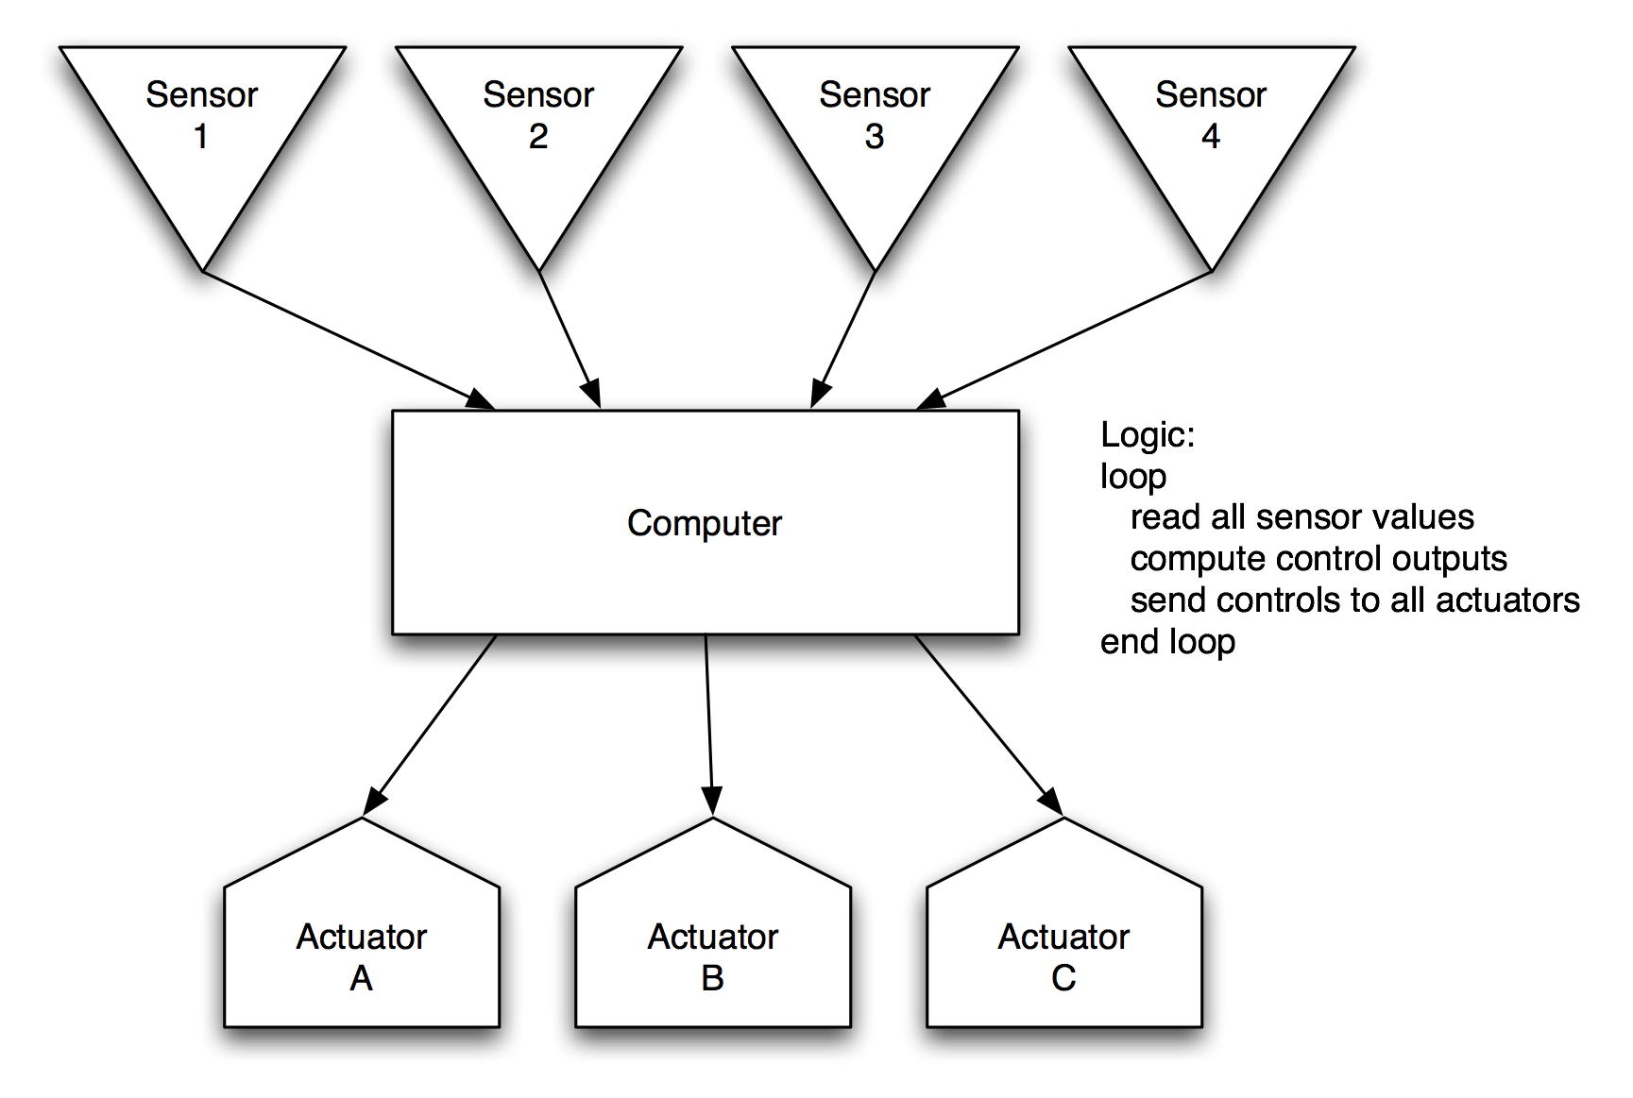
Sense-Compute-Control
Objective: Structuring embedded control applications
Software Architecture: Foundations, Theory, and Practice; Richard N. Taylor, Nenad Medvidovic, and Eric M. Dashofy; © 2008 John Wiley & Sons, Inc. Reprinted with permission.

Slide 17
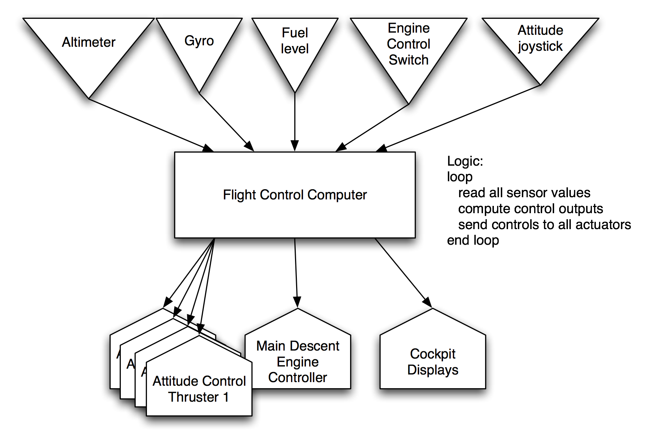
Sense-Compute-Control LL
Software Architecture: Foundations, Theory, and Practice; Richard N. Taylor, Nenad Medvidovic, and Eric M. Dashofy; © 2008 John Wiley & Sons, Inc. Reprinted with permission.

Slide 18
Architectural Styles
An architectural style is a named collection of architectural design decisions that
are applicable in a given development context
constrain architectural design decisions that are specific to a particular system within that context
elicit beneficial qualities in each resulting system
A primary way of characterizing lessons from experience in software system design
Reflect less domain specificity than architectural patterns
Useful in determining everything from subroutine structure to top-level application structure

Slide 19
Definitions of Architectural Style
Definition. An architectural style is a named collection of architectural design decisions that
are applicable in a given development context
constrain architectural design decisions that are specific to a particular system within that context
elicit beneficial qualities in each resulting system.
Recurring organizational patterns & idioms
Established, shared understanding of common design forms
Mark of mature engineering field.
Shaw & Garlan
Abstraction of recurring composition & interaction characteristics in a set of architectures
Taylor

Slide 20
Basic Properties of Styles
A vocabulary of design elements
Component and connector types; data elements
e.g., pipes, filters, objects, servers
A set of configuration rules
Topological constraints that determine allowed compositions of elements
e.g., a component may be connected to at most two other components
A semantic interpretation
Compositions of design elements have well-defined meanings
Possible analyses of systems built in a style

Slide 21
Benefits of Using Styles
Design reuse
Well-understood solutions applied to new problems
Code reuse
Shared implementations of invariant aspects of a style
Understandability of system organization
A phrase such as “client-server” conveys a lot of information
Interoperability
Supported by style standardization
Style-specific analyses
Enabled by the constrained design space
Visualizations
Style-specific depictions matching engineers’ mental models

Slide 22
Style Analysis Dimensions
What is the design vocabulary?
Component and connector types
What are the allowable structural patterns?
What is the underlying computational model?
What are the essential invariants of the style?
What are common examples of its use?
What are the (dis)advantages of using the style?
What are the style’s specializations?

Slide 23
Some Common Styles
Traditional, language-influenced styles
Main program and subroutines
Object-oriented
Layered
Virtual machines
Client-server
Data-flow styles
Batch sequential
Pipe and filter
Shared memory
Blackboard
Rule based
Interpreter
Interpreter
Mobile code
Implicit invocation
Event-based
Publish-subscribe
Peer-to-peer
“Derived” styles
C2
CORBA

Slide 24
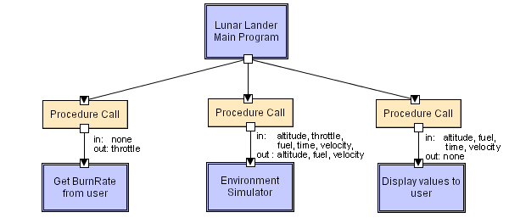
Main Program and Subroutines LL
Software Architecture: Foundations, Theory, and Practice; Richard N. Taylor, Nenad Medvidovic, and Eric M. Dashofy; © 2008 John Wiley & Sons, Inc. Reprinted with permission.
Notes:
Main program displays greetings and instructions, then enters a loop in which it calls the three subroutines in turn.

Slide 25
Object-Oriented Style
Components are objects
Data and associated operations
Connectors are messages and method invocations
Style invariants
Objects are responsible for their internal representation integrity
Internal representation is hidden from other objects
Advantages
“Infinite malleability” of object internals
System decomposition into sets of interacting agents
Disadvantages
Objects must know identities of servers
Side effects in object method invocations

Slide 26
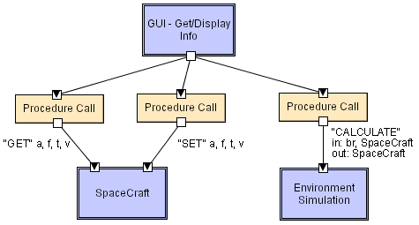
Object-Oriented LL
Can you list the differences between this and the function call style?
Software Architecture: Foundations, Theory, and Practice; Richard N. Taylor, Nenad Medvidovic, and Eric M. Dashofy; © 2008 John Wiley & Sons, Inc. Reprinted with permission.

Slide 27
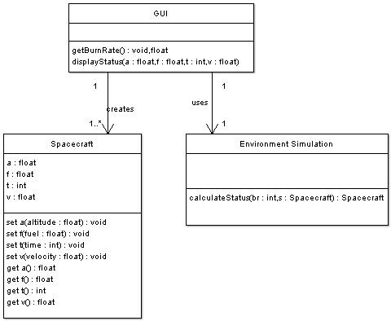
OO/LL in UML
Software Architecture: Foundations, Theory, and Practice; Richard N. Taylor, Nenad Medvidovic, and Eric M. Dashofy; © 2008 John Wiley & Sons, Inc. Reprinted with permission.

Slide 28
Class Exercise 4
Lets work on the class exercises.

Slide 29
Client-Server Pattern
Context: There are shared resources and services that large numbers of distributed clients wish to access, and for which we wish to control access or quality of service.
Problem: By managing a set of shared resources and services, we can promote modifiability and reuse, by factoring out common services and having to modify these in a single location, or a small number of locations. We want to improve scalability and availability by centralizing the control of these resources and services, while distributing the resources themselves across multiple physical servers.
Solution: Clients interact by requesting services of servers, which provide a set of services. Some components may act as both clients and servers. There may be one central server or multiple distributed ones.

Slide 30
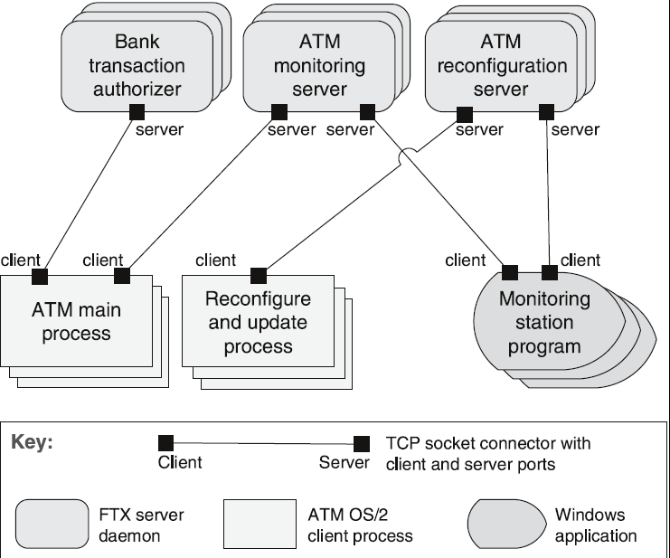
Client-Server Example

Slide 31
Client-Server Solution
Overview: Clients initiate interactions with servers, invoking services as needed from those servers and waiting for the results of those requests.
Elements:
Client, a component that invokes services of a server component. Clients have ports that describe the services they require.
Server: a component that provides services to clients. Servers have ports that describe the services they provide.
Request/reply connector: a data connector employing a request/reply protocol, used by a client to invoke services on a server. Important characteristics include whether the calls are local or remote, and whether data is encrypted.

Slide 32
Client-Server Solution
Relations: The attachment relation associates clients with servers.
Constraints:
Clients are connected to servers through request/reply connectors.
Server components can be clients to other servers.
Weaknesses:
Server can be a performance bottleneck.
Server can be a single point of failure.
Decisions about where to locate functionality (in the client or in the server) are often complex and costly to change after a system has been built.

Slide 33
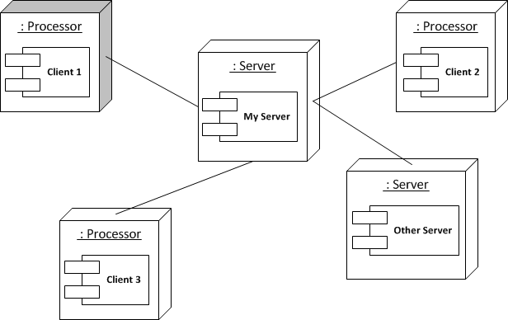
Client Server Basic Model: Clients invoke individual servers
Client process interact with individual server processes in a separate computer in order to access data or resource.
It is a distributed layered architecture with 2 layers (Client and Server layers)
Example:
Browser → search engine -> crawlers → other web servers.

Slide 34
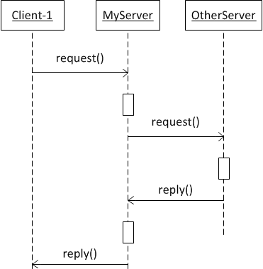
Clients and Servers
General interaction between a client and a server.

Slide 35
Client-Server Advantages
Where centralized data is required
Server is typically a high capacity machine (processing power to manage large number of connections and requests)
Clients are simple UI tasks
Many business applications use this architecture.

Slide 36
Client-Server Disadvantages
Single point of failure
Susceptible to denial of service attack
Network bandwidth limitations affect performance
Amount of requests can increase significantly if application is open to any users.

Slide 37
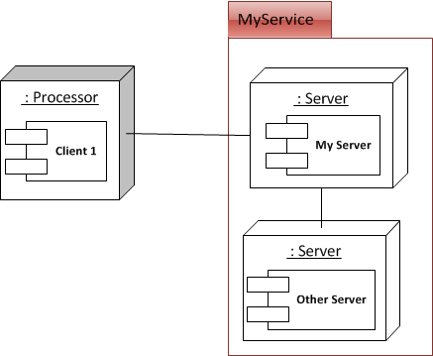
A service provided by multiple servers
Services may be implemented as several server processes in separate host computers.
Example: Cluster based Web servers and apps such as Google, parallel databases Oracle

Slide 38
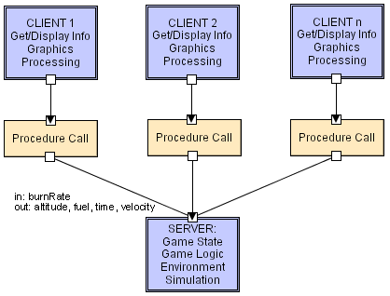
Client-Server LL – Taylor Notation
Software Architecture: Foundations, Theory, and Practice; Richard N. Taylor, Nenad Medvidovic, and Eric M. Dashofy; © 2008 John Wiley & Sons, Inc. Reprinted with permission.

Slide 39
Class Exercise
Define a suitable client-server architecture of a distributed cash register application.

Slide 40
Layered Style
Hierarchical system organization
“Multi-level client-server”
Each layer exposes an interface (API) to be used by above layers
Each layer acts as a
Server: service provider to layers “above”
Client: service consumer of layer(s) “below”
Connectors are protocols of layer interaction
This is really the same as the “N-tier” style
Example: operating systems
Virtual machine style results from fully opaque layers

Slide 41
Layered Architecture
When to Use the Layered Style
Layers make good modules since they have the following characteristics:
Each layer is highly cohesive
Layers provide natural support for information hiding (i.e. DBMS)
Layers are constrained to use only lower layers (eliminate coupling of layers above them)
Layering helps dividing big problems into smaller separate modules (layers)
Easy to modify (i.e. changes made to one layer are independent of the rest of the program)
In fact, one can remove an entire layer and replace it with a functionally equivalent component
Layered architectures are highly changeable

Slide 42
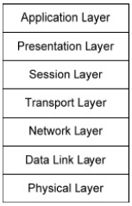
Layered Architecture – Network Stack
When to Use the Layered Style
Ethernet for wiring a building
Wireless connection

Slide 43
Layered Architecture
Disadvantages of Layered Style
Sometimes, data must pass through many layers
Can significantly slow performance
Layered programs can be difficult to debug because operations are implemented via a series of calls across several layers
Difficult to determine the exact number of layers
If only few layers →too big and complicated
If too many layers → each may lack coherence
Collaborations may be required to accomplish even simple tasks and hence performance may degrade

Slide 44
Layered Architecture - Example
Layered Style example:
A citation management system records bibliographic citations, searches them, and produces lists of references in a variety of bibliographic styles
Important Design Considerations:
Such programs must have user interfaces that are easily changed
They must also be able to incorporate new citation styles easily
The need to make the user interface easily changeable suggests that it should be a separate architectural component
Part of the program that formats citations should be separate from the part that stores, searches, and retrieves data
This suggests three major components:
User interface module
Citation formatter module,
Citation storage and retrieval module

Slide 45

Layered Architecture - Example
Layered Style example:
Clearly, user interface module must use services from the other two modules
In addition, citation formatter needs to use the storage and retrieval module
If we broaden the responsibilities of the citation formatter to include citation management responsibilities, then we have Strict Layered architecture

Slide 46
Layered Architecture - Example
Layered Style example:
User Interface
Responsible for user interaction
Uses: Citation Management module to store, retrieve, and format citations
Citation Management
Responsible for keeping track of all citations and formatting them as required
When it needs to store, search, or retrieve citations, it does so using the Citation Storage and Retrieval module
Citation Storage and Retrieval
Uses some sort of persistent storage mechanism (i.e. database or IR system) to hold citation records

Slide 47
Layered Architecture - Example
Layered Style example:
Summary:
Citation records have fields for every kind of citation do not change often
Storage and retrieval functionality of the Citation Storage and retrieval is quite stable do not change often
Citation Management modules changes when new formatting styles are added to the program
This does not affect Citation Storage and Retrieval
This only affects User Interface module (extent for new styles must be added to the user interface)
User interface can change without any effect on the other two modules

Slide 48
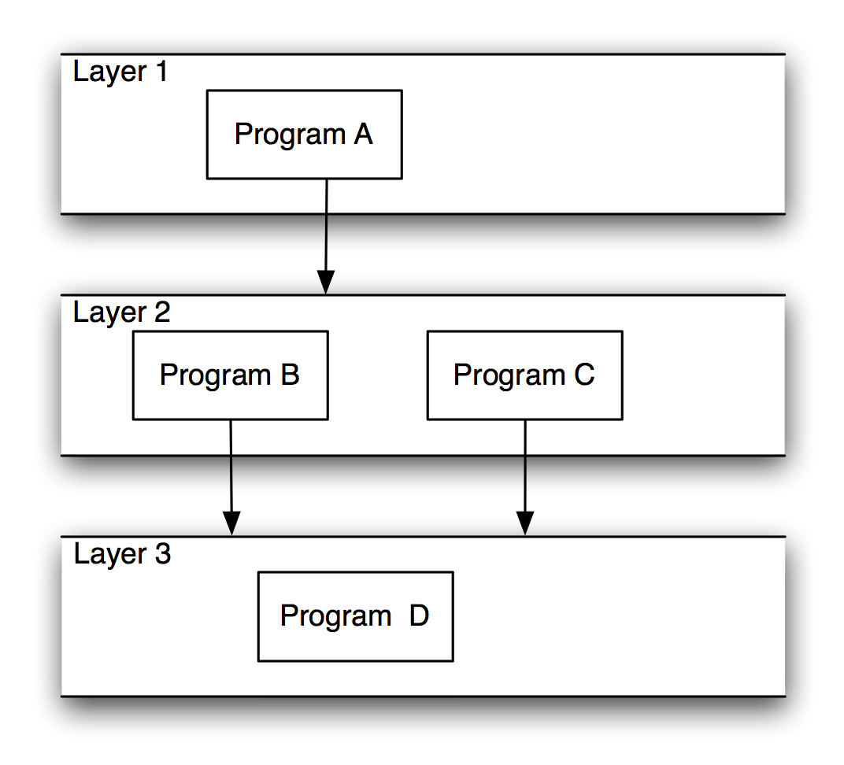
Layered Systems/Virtual Machines
Software Architecture: Foundations, Theory, and Practice; Richard N. Taylor, Nenad Medvidovic, and Eric M. Dashofy; © 2008 John Wiley & Sons, Inc. Reprinted with permission.

Slide 49
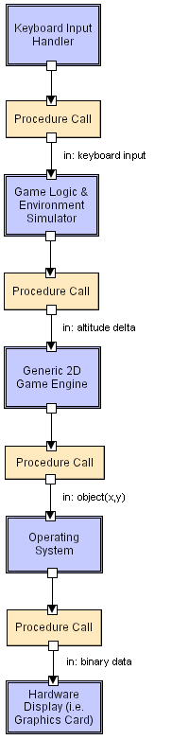
Layered LL
One typically does not see the Game Engine and OS listed in the layered architecture.
How else might one show this in UML?
Software Architecture: Foundations, Theory, and Practice; Richard N. Taylor, Nenad Medvidovic, and Eric M. Dashofy; © 2008 John Wiley & Sons, Inc. Reprinted with permission.

Slide 50
Class Exercise
Go back and review the client server architecture for the cash register and propose a layered view of that solution

Slide 51
Data-Flow Styles
Batch Sequential
Separate programs are executed in order; data is passed as an aggregate from one program to the next.
Connectors: “The human hand” carrying tapes between the programs, a.k.a. “sneaker-net ”
Data Elements: Explicit, aggregate elements passed from one component to the next upon completion of the producing program’s execution.
Typical uses: Transaction processing in financial systems. “The Granddaddy of Styles”

Slide 52
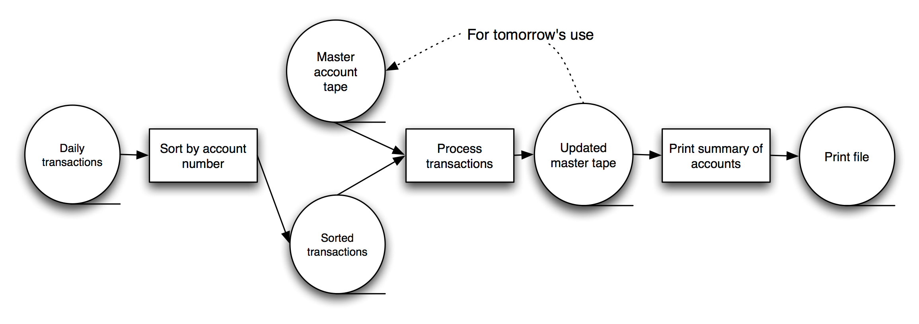
Batch-Sequential: A Financial Application
Software Architecture: Foundations, Theory, and Practice; Richard N. Taylor, Nenad Medvidovic, and Eric M. Dashofy; © 2008 John Wiley & Sons, Inc. Reprinted with permission.

Slide 53
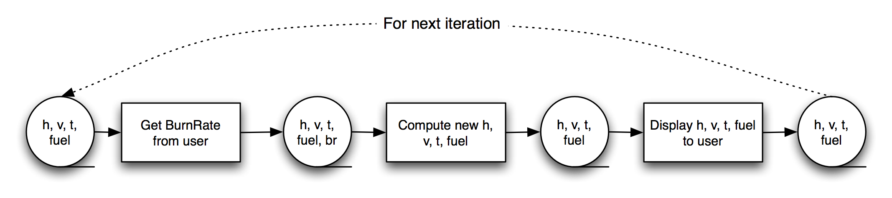
Batch-Sequential LL
Not a recipe for a successful lunar mission!
Why?
Software Architecture: Foundations, Theory, and Practice; Richard N. Taylor, Nenad Medvidovic, and Eric M. Dashofy; © 2008 John Wiley & Sons, Inc. Reprinted with permission.

Slide 54
Pipe and Filter Pattern
Context: Many systems are required to transform streams of discrete data items, from input to output. Many types of transformations occur repeatedly in practice, and so it is desirable to create these as independent, reusable parts.
Problem: Such systems need to be divided into reusable, loosely coupled components with simple, generic interaction mechanisms. In this way they can be flexibly combined with each other. The components, being generic and loosely coupled, are easily reused. The components, being independent, can execute in parallel.
Solution: The pattern of interaction in the pipe-and-filter pattern is characterized by successive transformations of streams of data. Data arrives at a filter’s input port(s), is transformed, and then is passed via its output port(s) through a pipe to the next filter. A single filter can consume data from, or produce data to, one or more ports.

Slide 55
Pipe and Filter Pattern
Types of Applications
Suitable for applications that require a well-defined series of independent computations to be performed on data
A component reads streams of data as input and produces streams of output data
Components (Filters)
A filter is a program component that transforms an input stream to an output stream.
Perform their computing incrementally
Output begins before all input is consumed
Connectors (Pipes)
Serve as conduits over which a stream of data flows (transmits the outputs of one filter to the inputs of another filter)
Pipe-and-Filter style is a dynamic model in which program components are filters connected by pipes

Slide 56
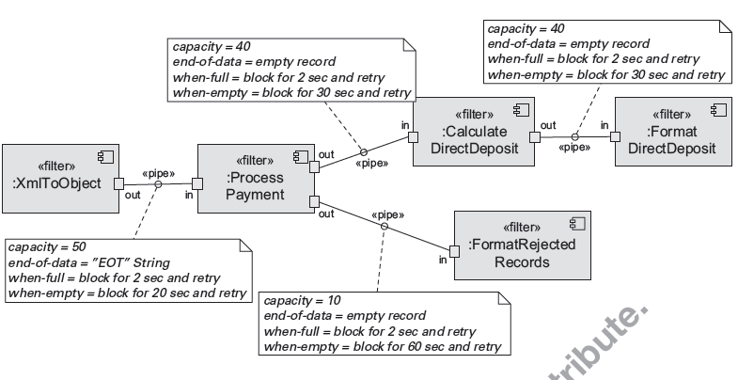
Pipe and Filter – Payment Process Example

Slide 57
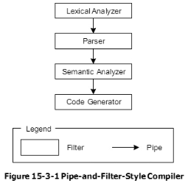
Pipe and Filter – Compiler Example
Classic Example: Compiler
Reads: Compiler reads a stream of characters comprising of source code of a program
Produces: Compiler produces a stream of machine-language instructions comprising of object code of the compiled program

Slide 58
Pipe and Filter – Compiler Example
Lexical Analyzer filter reads a stream of characters from a source code file and transforms it into a stream of tokens
Tokens are sent down a pipe to the Parser filter
Parser filter transforms tokens into a syntax tree representation
The syntax tree is sent down a pipe to the Semantic Analyzer filter
Semantic Analyzer filter process syntax tree by performing type checking and adding annotations to it
Annotated syntax is then sent through a pipe to the Code Generator filter
Code Generator filter transforms annotated syntax into a stream of machine-language instructions written to an object code file

Slide 59
Pipe and Filter Characteristics
Filters read input and produce output by enriching, refining, or converting it to another format
Enriching → adding information to it
Refining → compressing it or extracting information from it
Converting → changing its format
In the compiler example,
Semantic Analyzer enriches a syntax tree by adding annotations to it
Lexical Analyzer converts a stream of characters into stream of tokens

Slide 60
Pipe and Filter Characteristics
Filters do not share state with other filters
Filters do not know the identity of their upstream or downstream filters
Filters may begin producing output before it has consumed all its input
Filters may execute concurrently
If filters run concurrently, pipes need to synchronize them
A pipe may be a buffer that holds input filter’s output until its output filter is ready to accept it
A pipe may be implemented as a sub-program call

Slide 61
Pipe and Filter Topologies
Pipe-and-filter topologies should be acyclic graphs( no loops)
Avoids timing and deadlock issues
A simple linear arrangement of pipes and filters is called a pipeline
Restricts topologies to linear sequences of filters

Slide 62
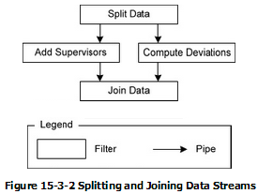
Pipe and Filter – Employee Filter Example
A program needs to convert a file listing employees, their employee numbers, and their salaries into a file listing the employees, their supervisors, and the difference between their salaries, and the mean company salary

Slide 63
Pipe and Filter Topologies
Example
Split Data filter
Task 1:
Reads the input data file,
Pulls out the name and identifier data , and
Sends it down a pipe to the Add Supervisors filter
Task 2:
Pulls out the salary data and sends it to the Computer Deviations filter
Add Supervisors filter
Replaces each employee number with that employee’s supervisor
Sends the result down a pipe to Join data

Slide 64
Pipe and Filter Topologies
Example
Computer Deviations filter
Computes the difference between each salary and the mean company salary
Sends the result down a pipe to the Join Data filter
Join Data filter
Puts the two data streams together and prints the resulting report

Slide 65
Pipe and Filter - Advantages
Advantages of Pipe-and-Filter Style
Filters can be modified or replaced easily
Simple to change the program to fix a problem or modify its behavior
Easy to understand and develop
Easy to develop several programs that do similar tasks
Filters are highly reusable
Concurrency is supported and is relatively easy to implement (as long as pipes’ synchronization is supported)

Slide 66
Pipe and Filter Disadvantages
Disadvantages of Pipe-and-Filter Style
Filters communicate only through pipes
Difficult for them to coordinate their activities
Not good for interactive systems
Filters usually consume and produce very simple data streams
Have to spend a lot of effort converting input into a usable form and then converting results back to simple format for output
Excessive parsing and unparsing leads to performance degrades and increased complexity in writing filters
Error handling is difficult
Pipes may not synchronize filters effectively (some filters may need to wait for all their input before doing any output)

Slide 67

Pipe and Filter LL – Taylor Notation
Software Architecture: Foundations, Theory, and Practice; Richard N. Taylor, Nenad Medvidovic, and Eric M. Dashofy; © 2008 John Wiley & Sons, Inc. Reprinted with permission.
Notes:
GetBurnRate runs continuously on its own, prompting the user for a new burn rate.
In this design the “compute new values” determines how much time has passed. Could alternatively do that in the GetBurnRate filter. Would change semantics a bit.

Slide 68
Class Exercise
Define a suitable pipe and filter architecture for the cash register application.

Slide 69
Blackboard Style
Two kinds of components
Central data structure — blackboard
Components operating on the blackboard
System control is entirely driven by the blackboard state
Examples
Typically used for AI systems
Integrated software environments (e.g., Interlisp)
Compiler architecture

Slide 70
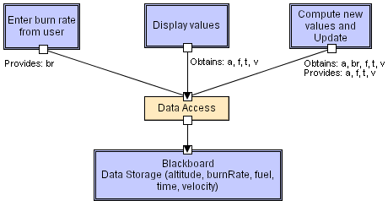
Blackboard LL
Software Architecture: Foundations, Theory, and Practice; Richard N. Taylor, Nenad Medvidovic, and Eric M. Dashofy; © 2008 John Wiley & Sons, Inc. Reprinted with permission.

Slide 71
Rule-Based Style
Inference engine parses user input and determines whether it is a fact/rule or a query. If it is a fact/rule, it adds this entry to the knowledge base. Otherwise, it queries the knowledge base for applicable rules and attempts to resolve the query.

Slide 72
Rule-Based Style (cont’d)
Components: User interface, inference engine, knowledge base
Connectors: Components are tightly interconnected, with direct procedure calls and/or shared memory.
Data Elements: Facts and queries
Behavior of the application can be very easily modified through addition or deletion of rules from the knowledge base.
Caution: When a large number of rules are involved understanding the interactions between multiple rules affected by the same facts can become very difficult.

Slide 73
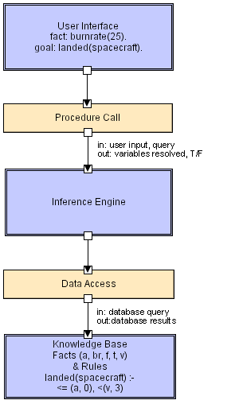
Rule Based LL
Software Architecture: Foundations, Theory, and Practice; Richard N. Taylor, Nenad Medvidovic, and Eric M. Dashofy; © 2008 John Wiley & Sons, Inc. Reprinted with permission.

Slide 74
Interpreter Style
Interpreter parses and executes input commands, updating the state maintained by the interpreter
Components: Command interpreter, program/interpreter state, user interface.
Connectors: Typically very closely bound with direct procedure calls and shared state.
Highly dynamic behavior possible, where the set of commands is dynamically modified. System architecture may remain constant while new capabilities are created based upon existing primitives.
Superb for end-user programmability; supports dynamically changing set of capabilities
Lisp and Scheme

Slide 75
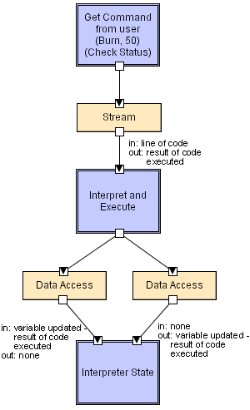
Interpreter LL
Software Architecture: Foundations, Theory, and Practice; Richard N. Taylor, Nenad Medvidovic, and Eric M. Dashofy; © 2008 John Wiley & Sons, Inc. Reprinted with permission.

Slide 76
Mobile-Code Style
Summary: a data element (some representation of a program) is dynamically transformed into a data processing component.
Components: “Execution dock”, which handles receipt of code and state; code compiler/interpreter
Connectors: Network protocols and elements for packaging code and data for transmission.
Data Elements: Representations of code as data; program state; data
Variants: Code-on-demand, remote evaluation, and mobile agent.

Slide 77
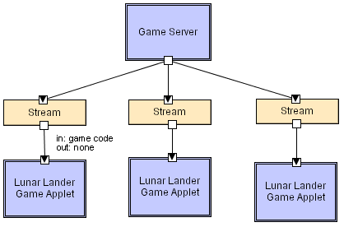
Mobile Code LL
Scripting languages (i.e. JavaScript,
VBScript), ActiveX control,
embedded Word/Excel macros.
Software Architecture: Foundations, Theory, and Practice; Richard N. Taylor, Nenad Medvidovic, and Eric M. Dashofy; © 2008 John Wiley & Sons, Inc. Reprinted with permission.

Slide 78
Implicit Invocation Style
Event announcement instead of method invocation
“Listeners” register interest in and associate methods with events
System invokes all registered methods implicitly
Component interfaces are methods and events
Two types of connectors
Invocation is either explicit or implicit in response to events
Style invariants
“Announcers” are unaware of their events’ effects
No assumption about processing in response to events

Slide 79
Implicit Invocation (cont’d)
Advantages
Component reuse
System evolution
Both at system construction-time & run-time
Disadvantages
Counter-intuitive system structure
Components relinquish computation control to the system
No knowledge of what components will respond to event
No knowledge of order of responses

Slide 80
Publish-Subscribe
Subscribers register/deregister to receive specific messages or specific content. Publishers broadcast messages to subscribers either synchronously or asynchronously.

Slide 81
Publish-Subscribe (cont’d)
Components: Publishers, subscribers, proxies for managing distribution
Connectors: Typically a network protocol is required. Content-based subscription requires sophisticated connectors.
Data Elements: Subscriptions, notifications, published information
Topology: Subscribers connect to publishers either directly or may receive notifications via a network protocol from intermediaries
Qualities yielded Highly efficient one-way dissemination of information with very low-coupling of components

Slide 82
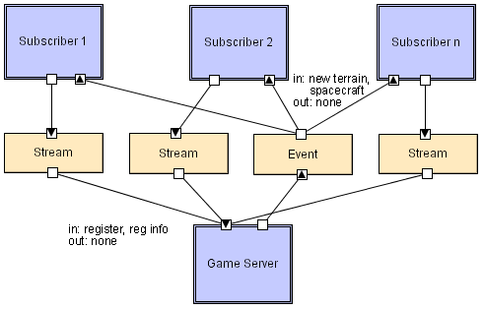
Pub-Sub LL
Software Architecture: Foundations, Theory, and Practice; Richard N. Taylor, Nenad Medvidovic, and Eric M. Dashofy; © 2008 John Wiley & Sons, Inc. Reprinted with permission.

Slide 83
Class Exercise
Define a suitable pub/sub architecture for the cash register application.

Slide 84
Event-Driven Pattern
In Publish-Subscribe the publisher is responsible for maintaining the list of subscribers.
What if the subscribers were responsible for knowing their publishers?
We no longer need to distinguish publishers and subscribers!

Slide 85
Event-Based Style
Independent components asynchronously emit and receive events communicated over event buses
Components: Independent, concurrent event generators and/or consumers
Connectors: Event buses (at least one)
Data Elements: Events – data sent as a first-class entity over the event bus
Topology: Components communicate with the event buses, not directly to each other.
Variants: Component communication with the event bus may either be push or pull based.
Highly scalable, easy to evolve, effective for highly distributed applications.

Slide 86
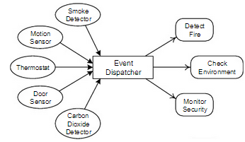
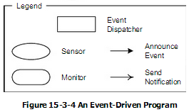
Event-Driven Pattern - Example
Consider a building monitoring system consisting of many sensors scattered around a building. The sensors might be smoke detectors, motion sensors, or door and window sensors. All detectors register events with an event dispatcher. Monitoring programs may register with the event dispatcher to check on ﬁre safety, building security, and environmental safety.

Slide 87
Event-Driven Pattern - Variations
Event-Driven systems may vary in many ways:
Events may be simple notifications or they may carry data
Events may have priorities or timing constraints honored by the dispatcher, or the dispatcher may manipulate events.
Events may be dispatched synchronously (i.e. wait for operations to complete) or asynchronously (i.e. execute them without waiting for them to return)
Event registration may be constrained in various ways (i.e. components may be allowed to register or unregister arbitrarily during execution)

Slide 88
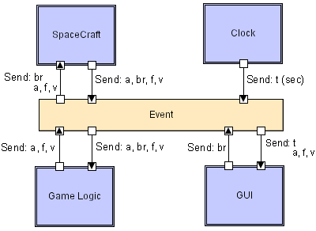
Event-based LL
Lunar Lander Event Bus
Clock publishes timing events on the bus
Software Architecture: Foundations, Theory, and Practice; Richard N. Taylor, Nenad Medvidovic, and Eric M. Dashofy; © 2008 John Wiley & Sons, Inc. Reprinted with permission.

Slide 89
Event-Driven Pattern – Advantages
Advantages:
Components that announce events have no connection to the components that respond to them
Style completely decouples components announcing events from components responding to them
It is easy to add, remove, or change components
Programs written in this style are changeable and maintainable
The independence of program components supports reusability, robustness, and fault tolerance.
Components can be introduced to system by simply registering it for events in the system

Slide 90
Event-Driven Pattern – Disadvantages
Disadvantages:
Components that announce an event:
Cannot guarantee that any components respond to them
Cannot have expectations about the order in which components respond
Event traffic tends to be highly variable
Sometimes event dispatcher is idle and at other times it is swamped with events
Performance issues

Slide 91
Peer-to-Peer Style
State and behavior are distributed among peers which can act as either clients or servers.
Peers: independent components, having their own state and control thread.
Connectors: Network protocols, often custom.
Data Elements: Network messages

Slide 92
Peer-to-Peer Style (cont’d)
Topology: Network (may have redundant connections between peers); can vary arbitrarily and dynamically
Supports decentralized computing with flow of control and resources distributed among peers. Highly robust in the face of failure of any given node. Scalable in terms of access to resources and computing power. But caution on the protocol!

Slide 93
Peer-to-Peer Solution
Overview: Computation is achieved by cooperating peers that request service from and provide services to one another across a network.
Elements:
Peer, which is an independent component running on a network node. Special peer components can provide routing, indexing, and peer search capability.
Request/reply connector, which is used to connect to the peer network, search for other peers, and invoke services from other peers. In some cases, the need for a reply is done away with.
Relations: The relation associates peers with their connectors. Attachments may change at runtime.

Slide 94
Peer-to-Peer Solution
Constraints: Restrictions may be placed on the following:
The number of allowable attachments to any given peer
The number of hops used for searching for a peer
Which peers know about which other peers
Some P2P networks are organized with star topologies, in which peers only connect to supernodes.
Weaknesses:
Managing security, data consistency, data/service availability, backup, and recovery are all more complex.
Small peer-to-peer systems may not be able to consistently achieve quality goals such as performance and availability.

Slide 95
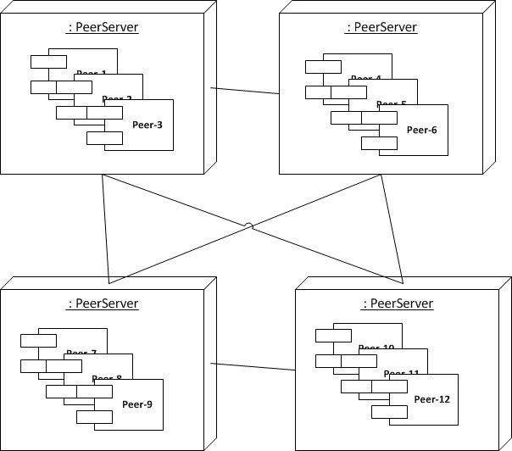
Peer Processes: A distributed application based on peer processes
All of the processes play similar roles, interacting cooperatively as peers to perform a distributed activities or computations without distinction between clients and servers.
Example: Distributed “white board” – users on several computers to view and interactively modify a picture between them.

Slide 96
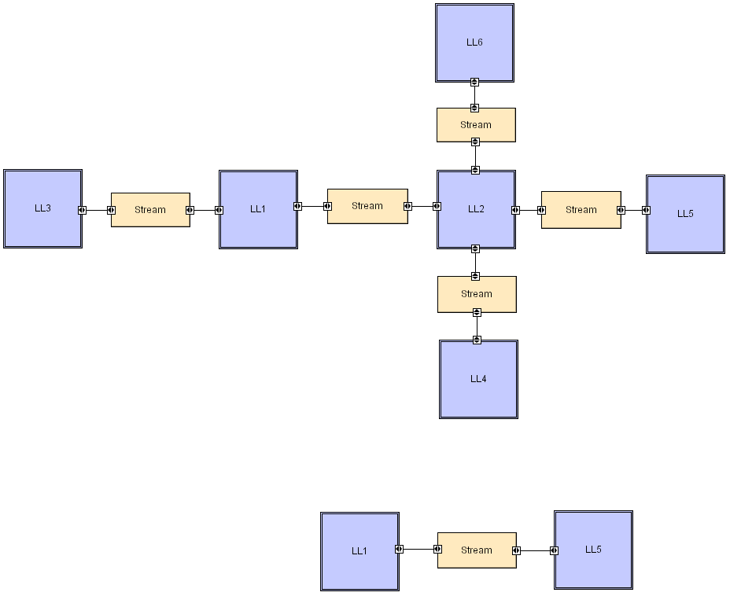
Peer-to-Peer LL
Software Architecture: Foundations, Theory, and Practice; Richard N. Taylor, Nenad Medvidovic, and Eric M. Dashofy; © 2008 John Wiley & Sons, Inc. Reprinted with permission.

